Slide 1
Meadows Museum
Pre-Visit Lesson

Slide 2
Learning Objectives
Students will be able to...
define museum.
understand what a visit to the Meadows Museum is like.
describe appropriate museum behavior.
interpret how long it takes to look at a work of art.
know the learning goals of the tour at the Meadows Museum.
define specific tour vocabulary.

Slide 3
Have you been to a museum before?
What kind of museum did you visit?
What was it like?

Slide 4
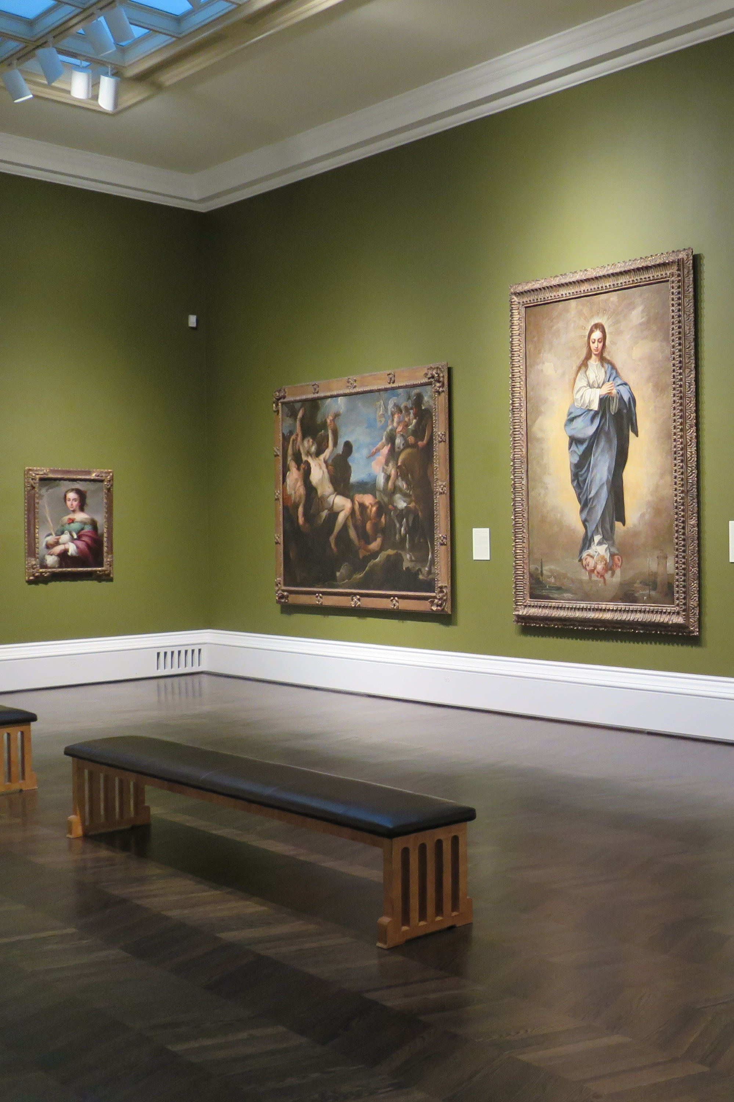
What is a museum?
A museum is a place that collects and preserves things. People visit museums to learn about these things. They can learn about them by looking, talking, and making.

Slide 5
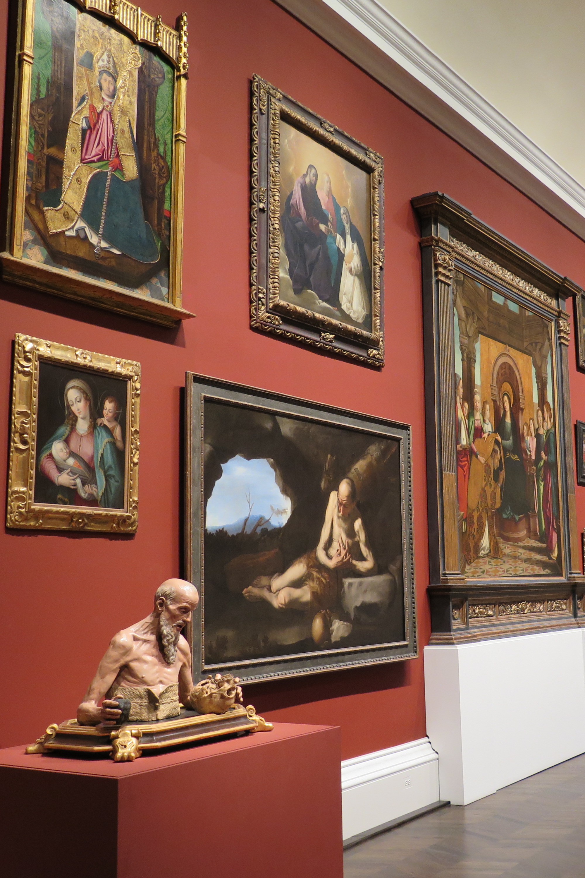
Why do you think museums are important?

Slide 6
The Meadows Museum …
is an art museum of art from Spain.
is located on the campus of Southern Methodist University in Dallas.
was founded by Algur H. Meadows.
opened in 1965.
How old is the museum today?

Slide 7
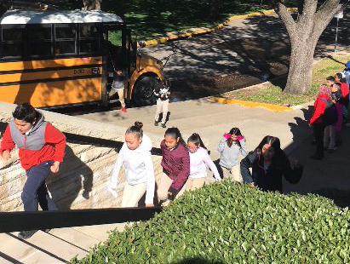
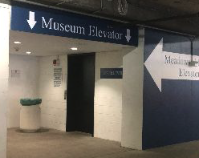
When you arrive, …
the bus will drop you off in front of the museum. You will use the stairs or the elevator in the parking garage to get to the museum's entrance.

Slide 8
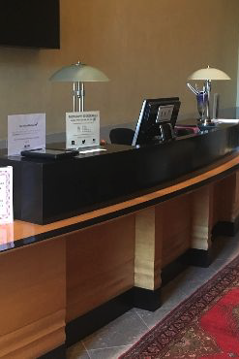
When you enter the museum, …
your teacher will check in at the front desk, and your docent will meet you in the lobby. A docent is a tour guide who will lead you through the galleries.

Slide 9
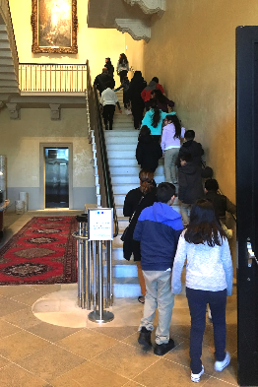
To get to the galleries, …
you can take the stairs or the elevator.

Slide 10
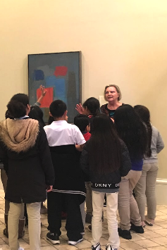
In the galleries, ...
you will look at artwork and share your ideas about it, but you cannot touch the art, frames, or pedestal stands.

Slide 11
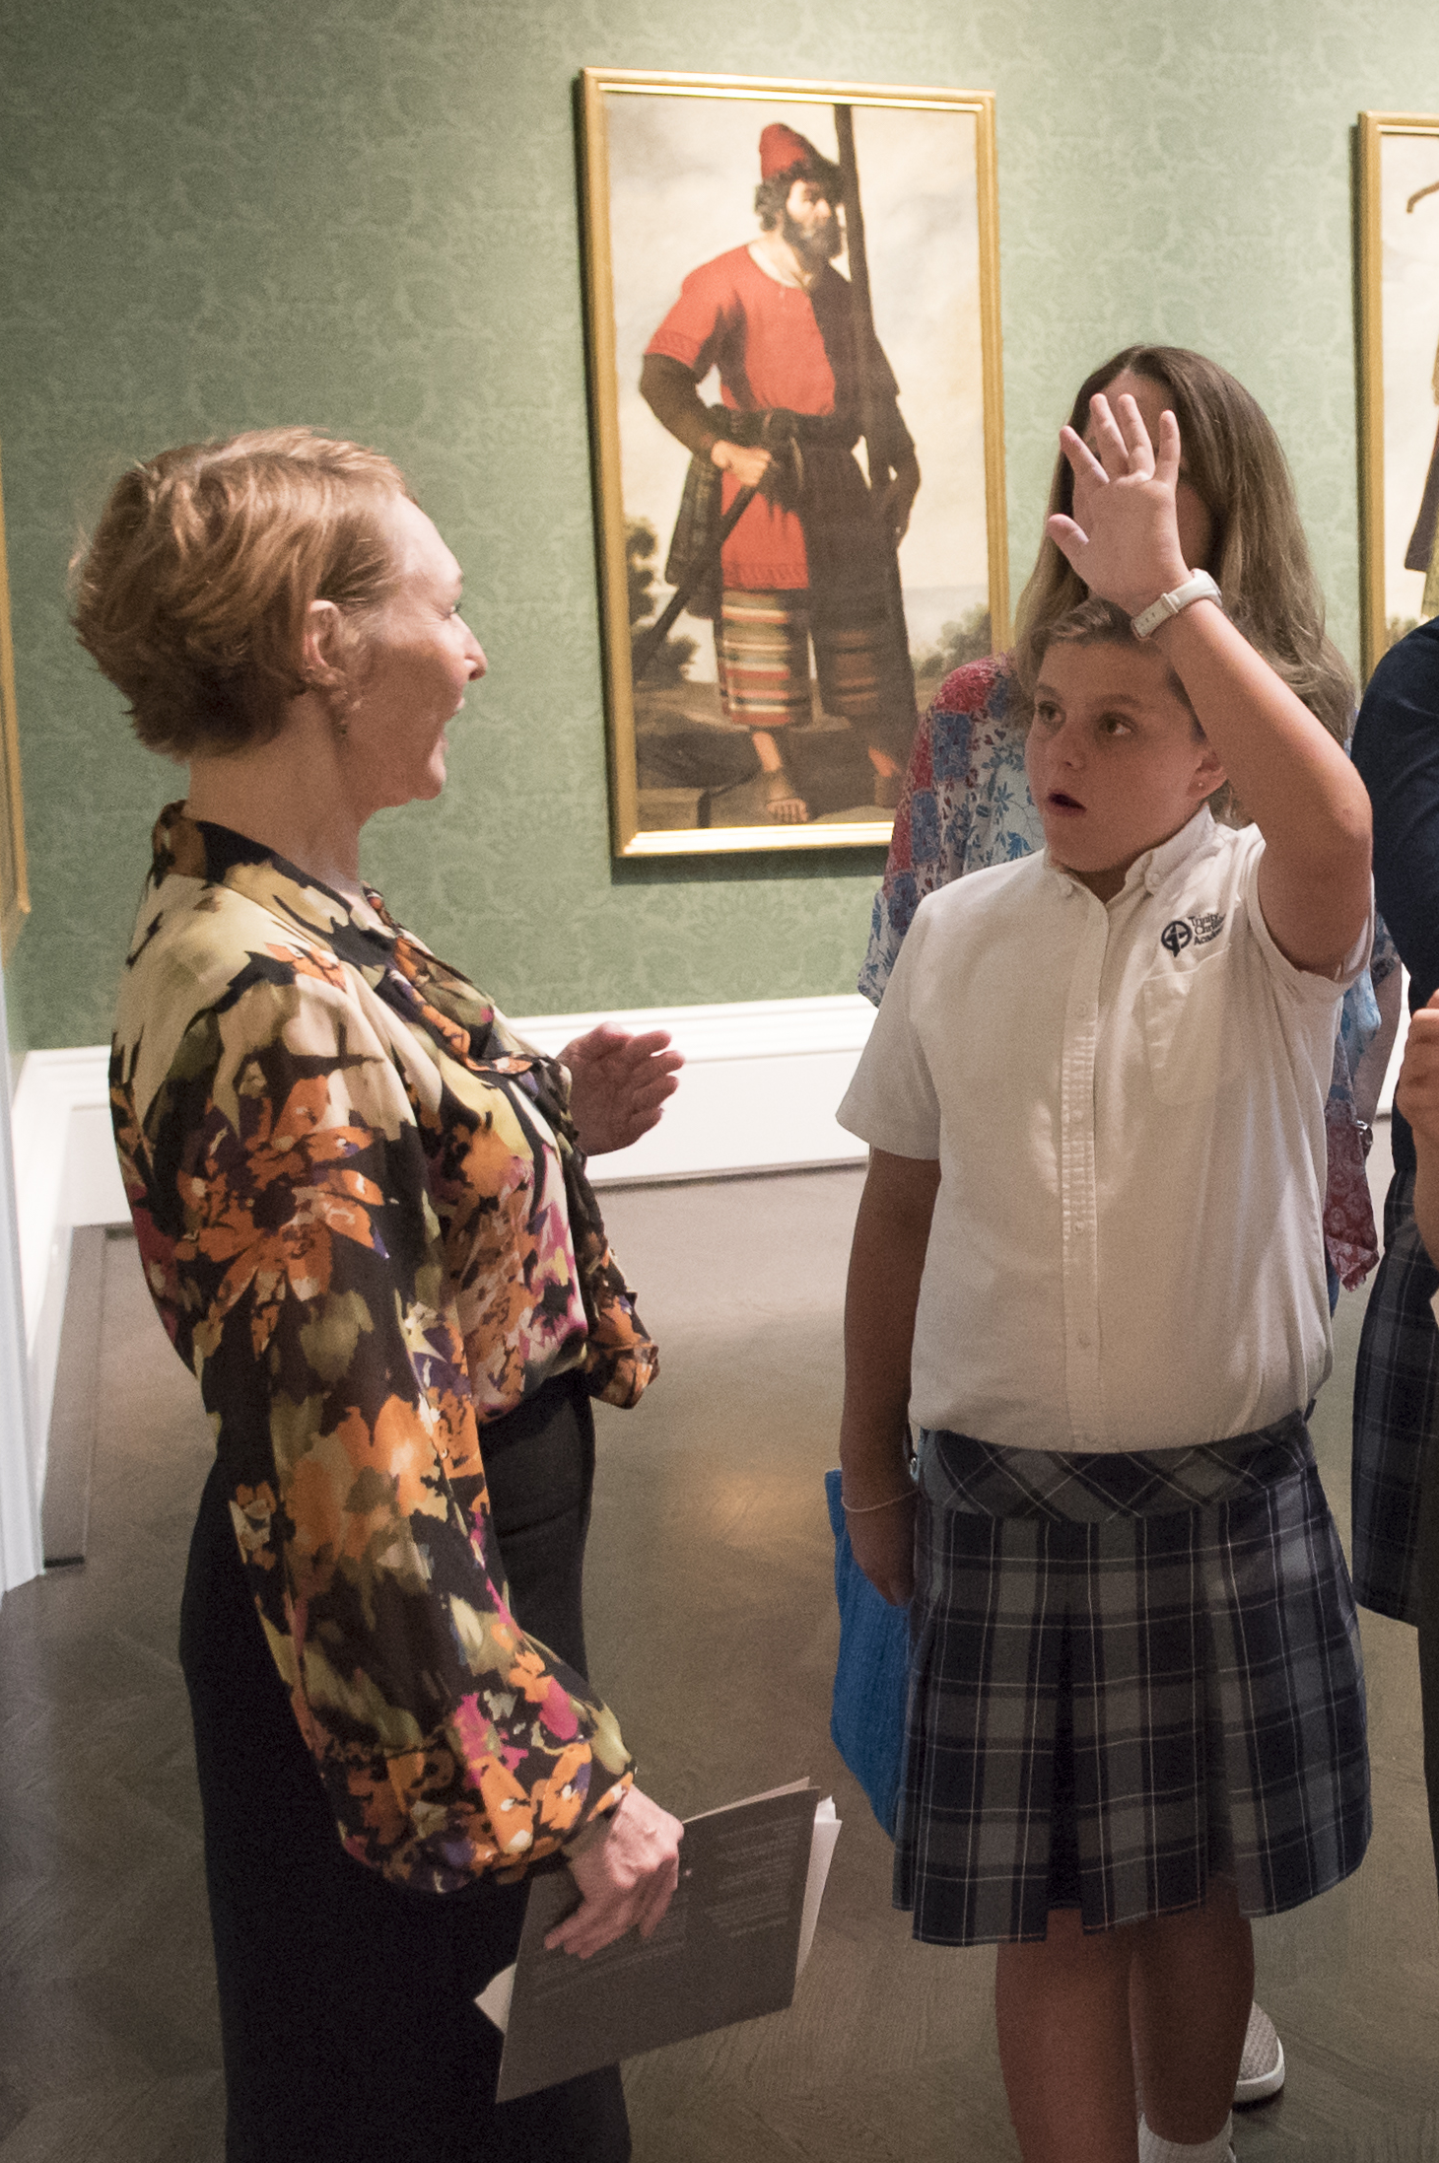
Why can’t we touch the art?
Have each person stick a piece of clear tape to their finger.
Remove the tape from your finger and put the tape on a piece of white paper.
What do you notice about the paper? How is it different from a new piece of white paper?

Slide 12
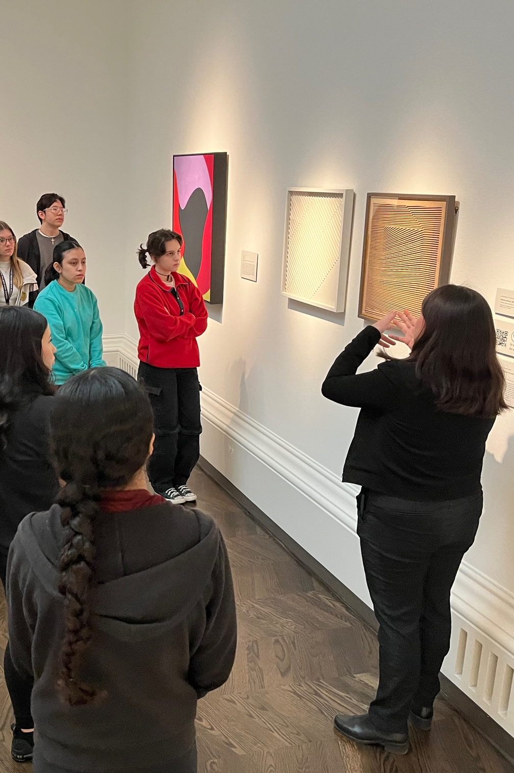
Can you think of any other rules to follow when you visit an art museum?

Slide 13
When you are in the galleries, …
you cannot lean on the walls.
you cannot have food, drinks, or gum.
you cannot have large bags, backpacks, or other bulky items.
you can take pictures without flash.
you will stay with your class.
you will use an inside voice.
you will not run.

Slide 14
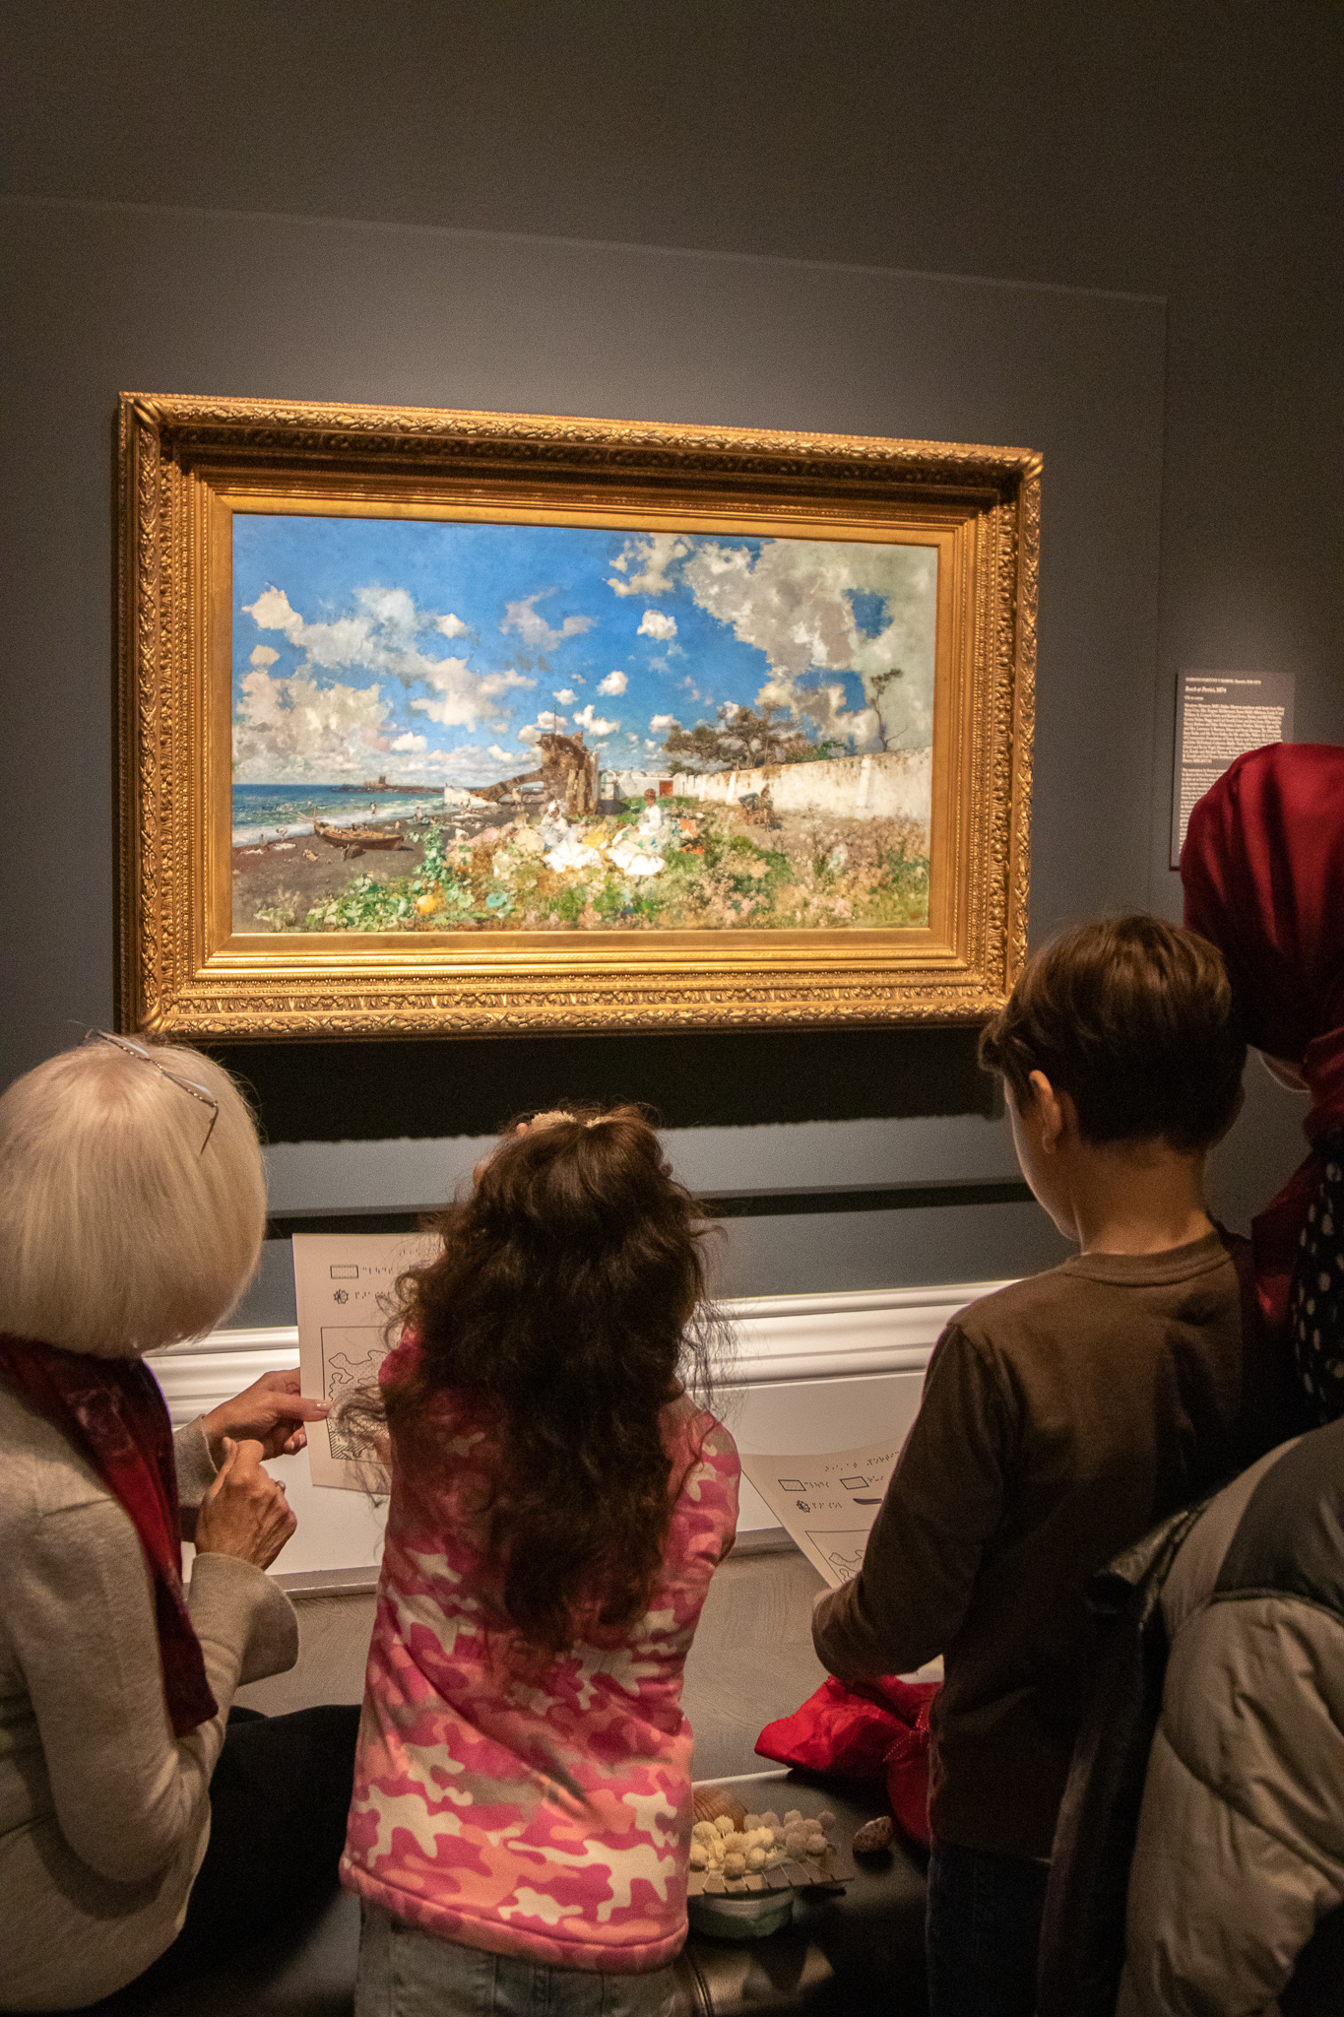
On your tour, …
you will look at art.
you will talk about art.
you might make art.
you might play games.
you might write about art.

Slide 15
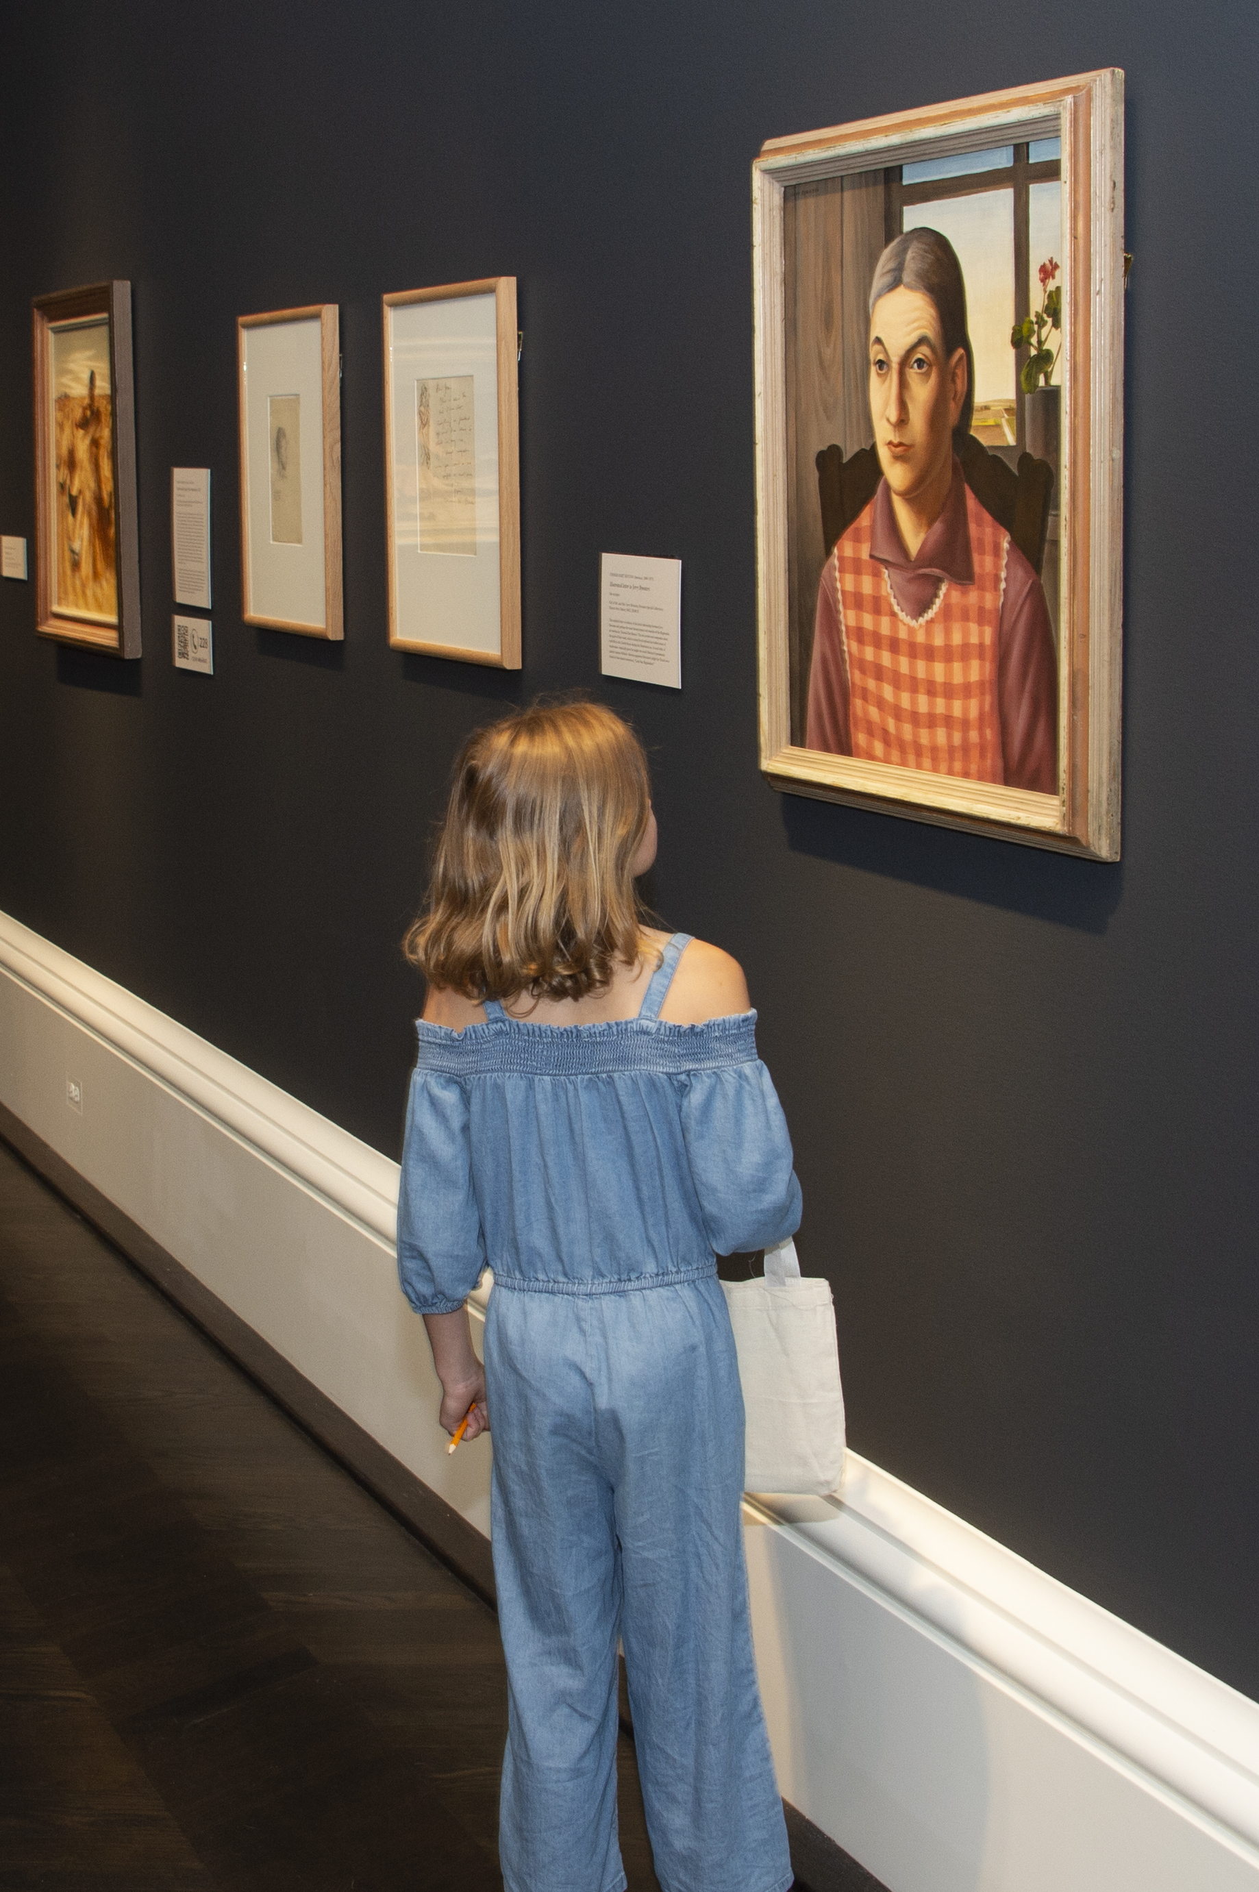
How long do you think you will spend looking at each work of art?

Slide 16
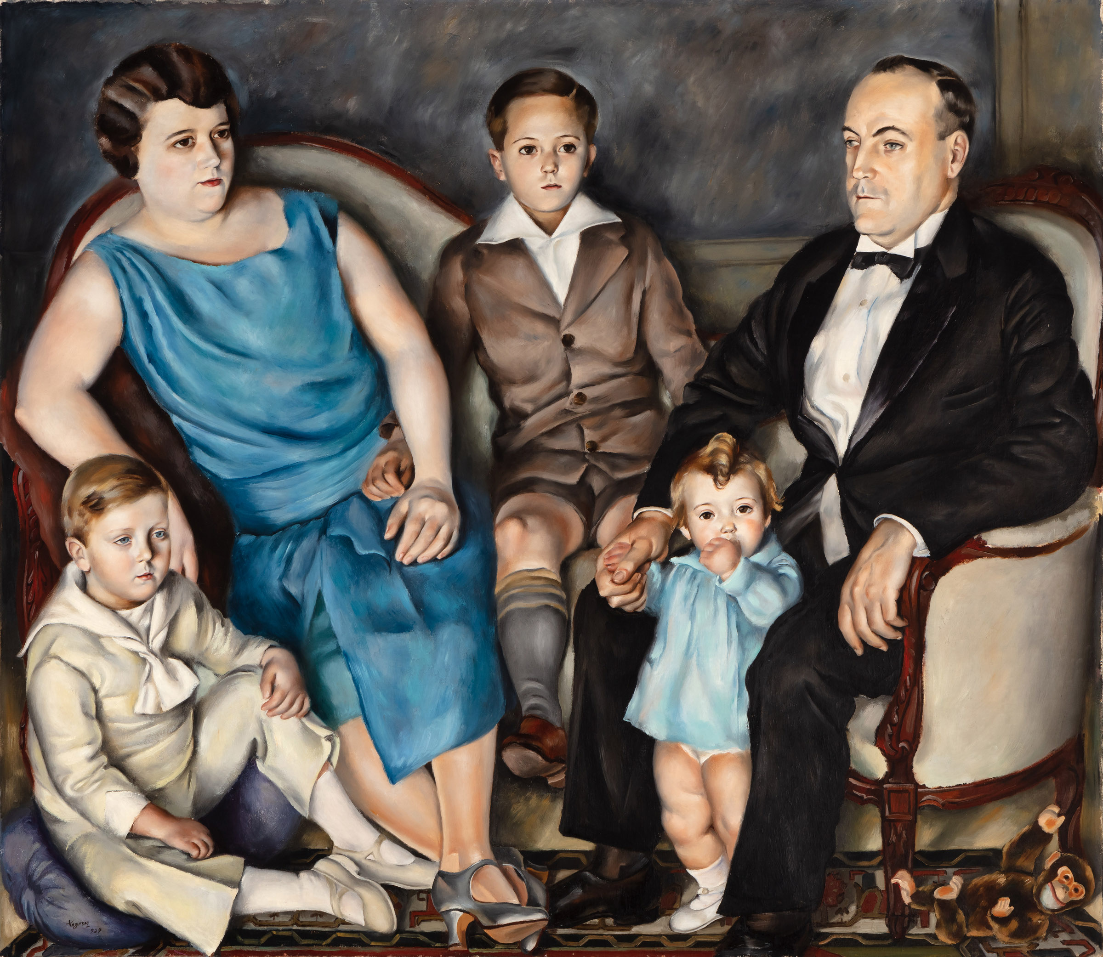

Is 30 seconds enough time?
Start the timer below. Look at the work of art to the left. Make a mental list of all the things you see.

Slide 17
Do you remember ...
how many people are in the painting?
what they are wearing?
where they are?
what colors are in the painting?
if there are any objects in the painting?
if there are any animals in the painting?

Slide 18
Is there anything you forgot? Is there anything you thought you saw, but didn’t?
How much more time do you think you needed?

Slide 19
Tour Specific Information

Slide 20
How to use these slides
The next slides include tour objectives and vocabulary for each tour type. (If you are not sure which tour type you are signed up for, check your confirmation letter.) Review the tour goals and objectives with your students. Following each tour vocabulary list is a slide for suggested activities to review the vocabulary terms. Feel free to add, edit, or delete slides to best serve your students.

Slide 21
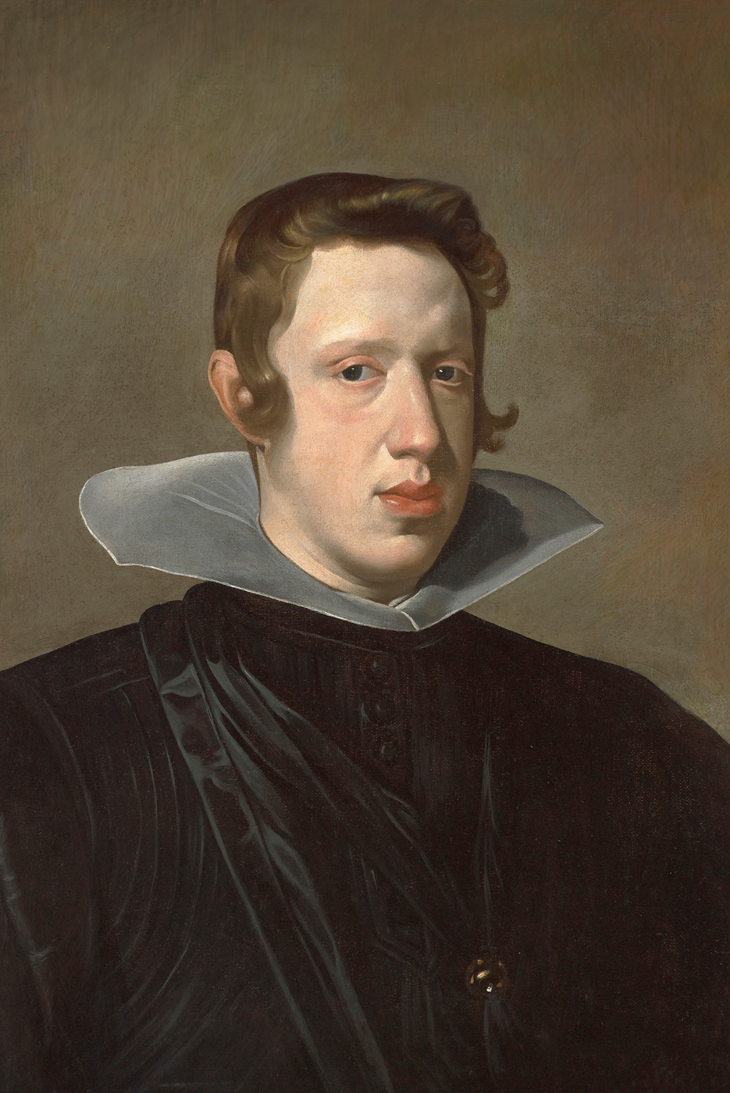
Portraits & Personalities Tour
K – 12th Grade
Students are invited to explore portraiture and discover how artists use facial expressions, body language, clothing, and background details to tell a story about their subjects. Students will learn to interpret visual clues, make connections to their own experiences, and consider what makes a portrait meaningful.

Slide 22
Portraits & Personalities Tour Objectives
Students will be able to...
define portrait,
discuss elements of portraiture,
understand the significance or purpose of portraits throughout history, and
interpret aspects of the sitter such as their age, socio-economic status, time period, profession, hobbies, and emotions.

Slide 23
Portraits & Personalities Tour Vocabulary
Portrait: a representation of a person or a group of people.
Sitter(s): the person or people who is/are shown in a portrait.
Self-portrait: a portrait of the artist that created it.
Facial Expression: the way the different parts of the face work together to show emotion.
Gestures: what the sitter does with his or her hands.
Posture: the position of the body of the sitter.
Setting: the place or environment in which the sitter is shown.
Attire: the clothing the person in the portrait is wearing.
Props: the things the sitter is holding or is surrounded by.
Commission: to order something to be made.
Artist: someone who creates art.

Slide 24
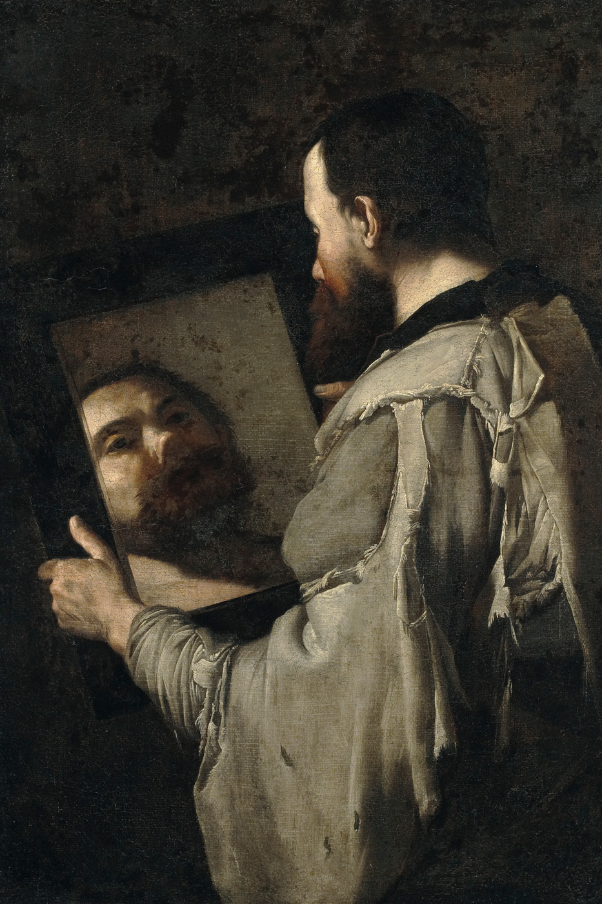
Demonstration of Learning (DOL)
Portrait Sitter Facial Expression Gestures
Posture Setting Attire Props Commission
Using the vocabulary words above, write a short story. Underline each of the vocabulary words in your story. Your story should be at least 3 paragraphs. Each paragraph should be 4-5 sentences long.

Slide 25
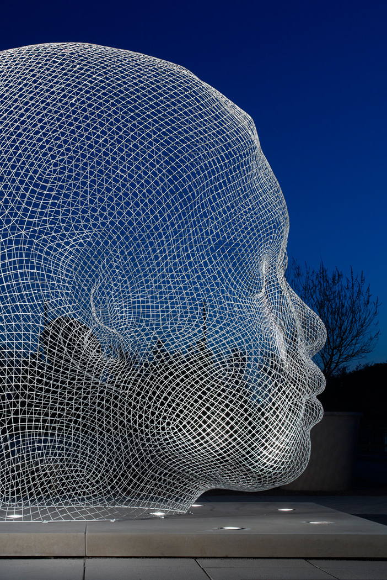
STEAM Tour
K – 12th Grade
This tour connects art with science, technology, engineering, and math (STEAM), showing students how artists use problem-solving, experimentation, and innovation in their creative process. By making connections between art and STEM disciplines, students will gain a deeper appreciation for the role of creativity in both artistic and scientific discovery.

Slide 26
STEAM Tour Objectives
Students will be able...
identify ways that artists use observation, experimentation, and problem-solving in the creative process,
analyze how artists innovate with materials and techniques to solve aesthetic or structural challenges, and
make interdisciplinary connections between visual art and STEM concepts.

Slide 27
STEAM Tour Vocabulary
Observation: Looking closely to notice details.
Process: The steps taken to create something.
Experimentation: Trying out new ideas or methods to see what works best.
Material: What something is made of (i.e. paint, metal, wood, or even digital tools).
Pigment: A substance that gives paint its color—made from natural or synthetic materials.
Technique: The way an artist uses tools and materials (i.e. the way an artist applies paint)
Design: A plan or sketch for how something will look or work.
Composition: The way parts of an artwork are arranged.

Slide 28
STEAM Tour Vocabulary
Structure: How something is built or put together, like a sculpture or a building.
Balance: How elements are arranged to create a sense of stability. It can be visual or physical.
Proportion: The relationship between sizes of different parts of a whole.
Symmetry: When one side of something is the same as the other side, like a mirror image.
Pattern: A repeated design or sequence.
Geometry: A branch of math that deals with shapes, sizes, and angles.
Innovation: A new idea or way of doing something that solves a problem or improves on what came before.
Engineering: The process of designing and building things to solve problems.

Slide 29
STEAM Tour Vocabulary
Technology: Tools, machines, or techniques that help us create or solve problems.
Functional Art: Art that is useful as well as beautiful (i.e. a decorative chair).
X-ray: A tool used by scientists and conservators to see beneath the surface of something such as a painting or sculpture.
Conservation: The science of preserving and protecting artworks so that they last a long time.

Slide 30
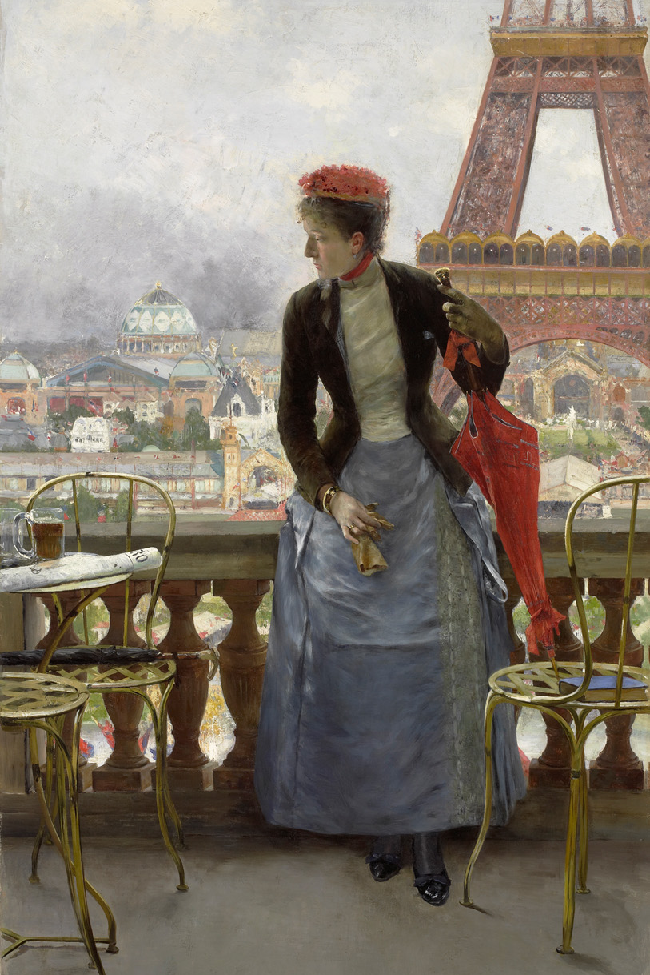
Demonstration of Learning (DOL)
Half the class will receive vocabulary word cards. The other half of the class will receive vocabulary definition cards.
When I say go, find your match. When you think you have found your match, check in with me.
The first pair to correctly match, wins!

Slide 31
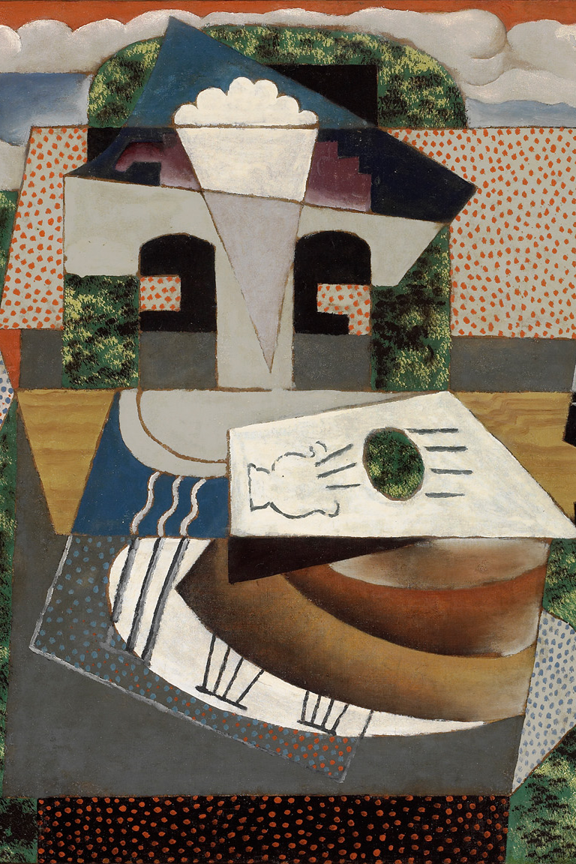
Artistic Ideas, Materials, & Processes Tour
K – 12th Grade
Students will consider the choices artists make to communicate their ideas, including subject matter, style, and media. They will gain insight into the artistic decision-making process and develop a deeper appreciation for the creativity behind each work of art.

Slide 32
Artistic Ideas, Materials, & Processes Tour Objectives
Students will be able...
analyze how artists use subject matter, style, and media to express ideas, emotions, and messages,
explore the creative decision-making process by considering why an artist chose particular materials, techniques, or visual elements,
develop visual literacy skills by interpreting how artistic choices influence the meaning and impact of a work of art, and
gain an appreciation for the role of creativity, experimentation, and intentionality in the creation of visual art.

Slide 33
Artistic Ideas, Materials, & Processes Tour Vocabulary
Artistic Process: The steps an artist takes to create a work of art, including planning, experimenting, and making decisions about materials and composition.
Studio: A workspace where artists create their work; sometimes multiple artists or assistants work together on one artwork in a studio.
Medium (Media): The material(s) an artwork is made of (i.e. oil paint, marble, ink, or collage).
Technique: The way an artist uses tools and materials (i.e. how they apply paint or carve stone).
Components: The individual parts or elements that make up a work of art, such as color, line, shape, and texture.
Composition: How the parts of an artwork are arranged and organized to create a whole.

Slide 34
Artistic Ideas, Materials, & Processes Tour Vocabulary
Line: A mark that can show shape, movement, or emotion in art. Lines can be straight, curved, thick, or thin.
Color: What we see when light reflects off an object.
Texture: How something looks or feels (i.e. rough, smooth, bumpy, or soft). Artists can show real or imagined textures.
Form: A three-dimensional shape—real or represented—like a sculpture or a painted object that looks 3D.
Style: The way an artist creates their work, like how they use line, color, and shape (i.e. realistic, abstract, expressive, etc).
Abstract: A style of art that does not show things exactly as they look in real life. It uses shapes, colors, and lines to express ideas or feelings.
En Plein Air: A French term meaning “in the open air,” used when artists paint or draw outside to capture natural light and scenery.

Slide 35
Artistic Ideas, Materials, & Processes Tour Vocabulary
Subject Matter: What the artwork is about or shows—such as people, places, events, or objects.
Symbol: An object, shape, or color that stands for something else, like a heart symbolizing love.
Mood: The feeling or emotion an artwork creates, such as peaceful, tense, joyful, or mysterious.
Expression: The way an artist shows emotions, ideas, or energy through their work.
Social Commentary: When an artwork communicates an opinion or message about society, politics, or culture.

Slide 36
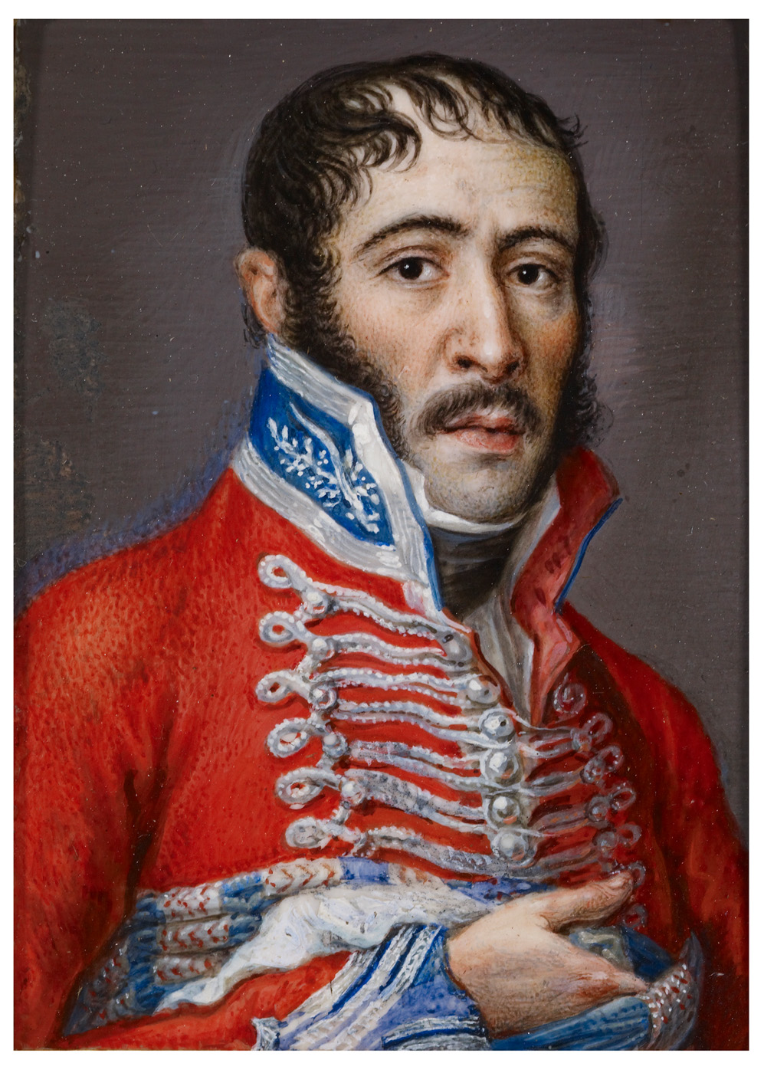
Demonstration of Learning (DOL)
Half the class will receive vocabulary word cards. The other half of the class will receive vocabulary definition cards.
When I say go, find your match. When you think you have found your match, check in with me.
The first pair to correctly match, wins!

Slide 37
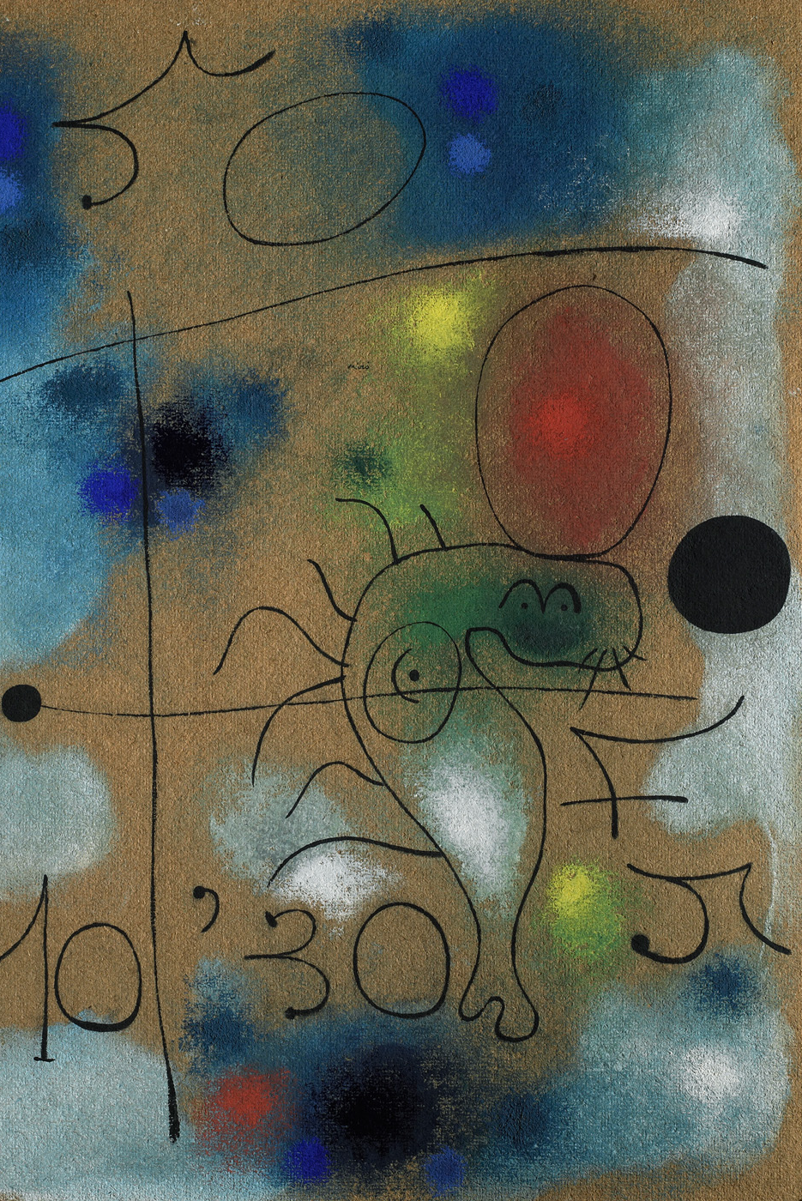
Learning to Look: Elements of Art Tour
K – 6th Grade
This interactive museum tour introduces students to the elements of art—line, shape, color, texture, space, value, and form—while exploring how artists use them to communicate ideas and create meaning. Through guided looking and discussion, students will develop visual literacy skills and learn how to interpret artworks.

Slide 38
Learning to Look: Elements of Art Tour Objectives
Students will be able to...
Identify the elements of art—line, shape, color, texture, space, value, and form—in works of art,
Describe and interpret the choices artists make in organizing visual elements and how those choices affect the meaning and mood of an artwork,
Develop visual literacy skills by observing closely, thinking critically, and expressing their ideas and interpretations through discussion and creative response.

Slide 39
Learning to Look: Elements of Art Tour Vocabulary
Color: the way we see light; artists use color to show feeling
Line: a mark that can show movement, emotion, or shape
Shape: flat areas made by lines (like circles, squares, or blobs)
Texture: how something feels or looks like it feels (rough, smooth, bumpy)
Space: the area around, between, and within objects
Value: the lightness or darkness of a color
Form: a three-dimensional object, or the illusion of three dimensions
Composition: how everything is arranged in an artwork
Portrait: a picture of a person
Figure: a person or character in a work of art
Perspective: seeing things from another person’s point of view
Mood: the feeling or atmosphere in the artwork

Slide 40
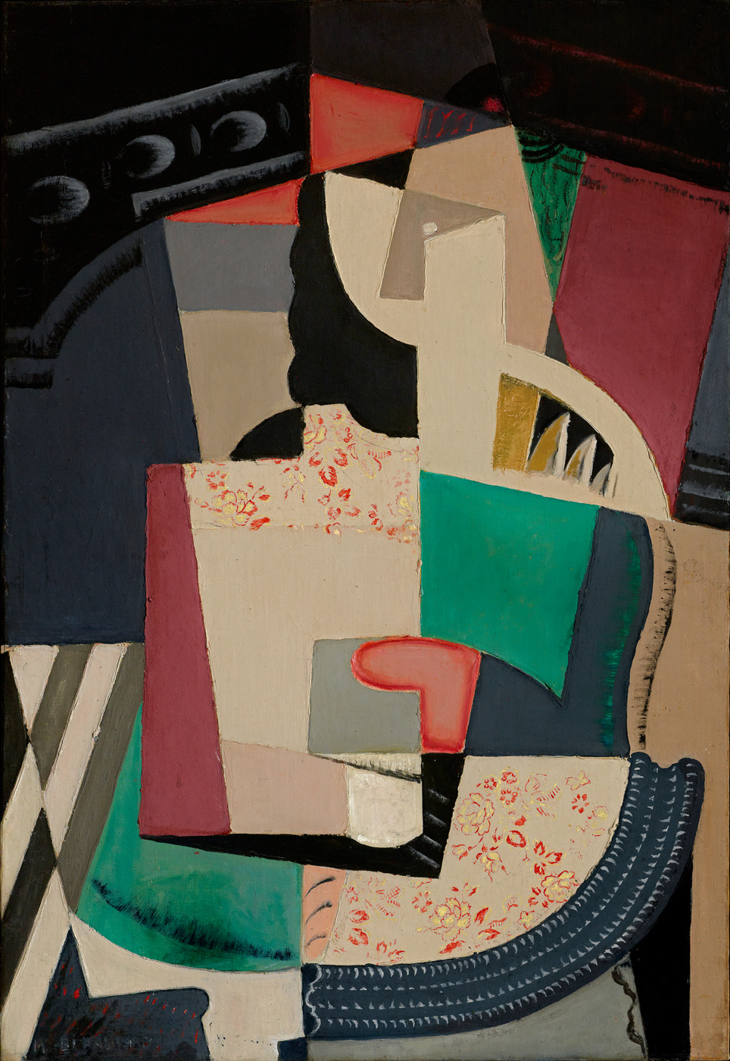
Demonstration of Learning (DOL)
On your handout, sketch or draw the definition of each vocabulary word.

Slide 41
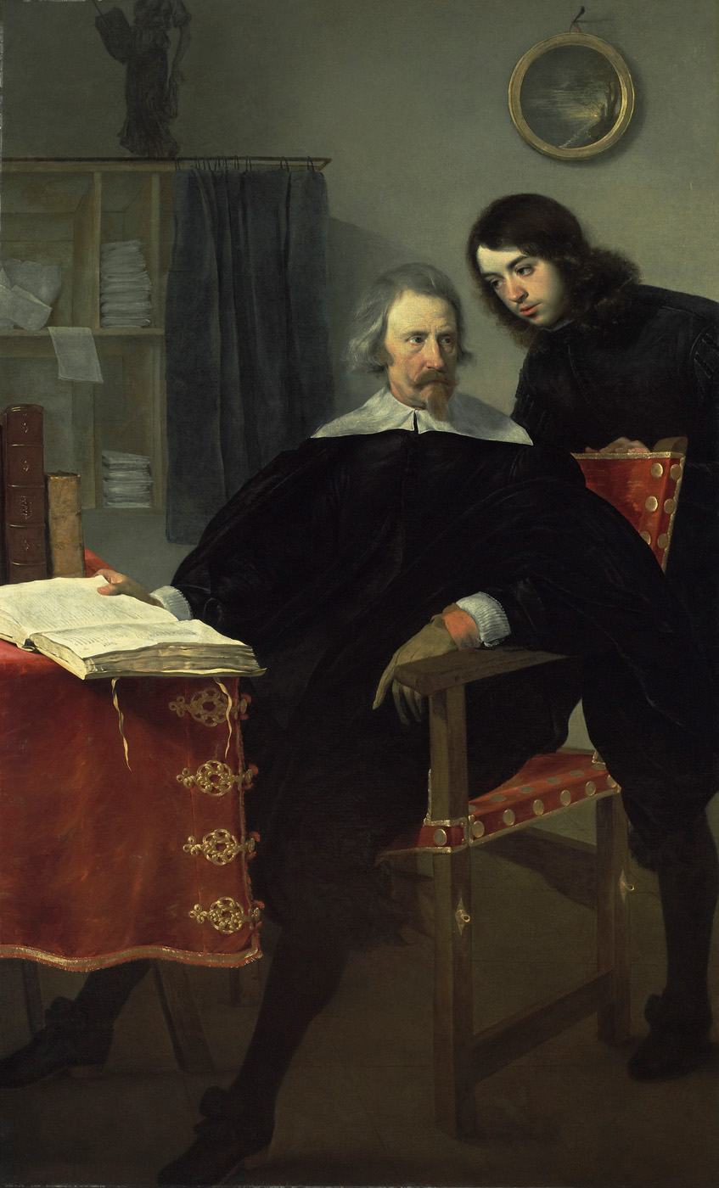
Learning to Look: Storytelling Tour
K – 6th Grade
Students will discover how artists tell stories through images, symbols, and characters. Guided by inquiry-based discussions, students will practice close looking and imaginative thinking as they uncover narratives hidden in works of art. Activities will encourage students to make connections to literature, build storytelling skills, and express their ideas with confidence.

Slide 42
Learning to Look: Storytelling Tour Objectives
Students will be able to...
identify how artists use images, symbols, and characters to tell stories,
discuss the narrative elements present in works of art, and
interpret and imagine details about the story being told, using clues from the artwork to infer character traits, actions, and outcomes.

Slide 43
Learning to Look: Storytelling Tour Vocabulary
Narrative: A story or account of events, whether real or imagined.
Composition: The arrangement of elements within a work of art.
Symbol: An image or object that represents a deeper meaning or idea.
Character: A figure in an artwork who may be part of a story.
Setting: The time and place depicted in a scene or image.
Mood: The feeling or atmosphere created by an artwork.
Gesture: The movement or pose of a figure that helps express emotion or action.
Expression: Facial or body language that shows how a character feels.
Plot: The sequence of events in a story.
Theme: The central idea or message in a story or artwork.
Imagery: Descriptive language or visual elements that appeal to the senses.
Dialogue: Conversation between characters that can be suggested or imagined in a scene. Can be an inner dialogue within the mind of a single character.

Slide 44
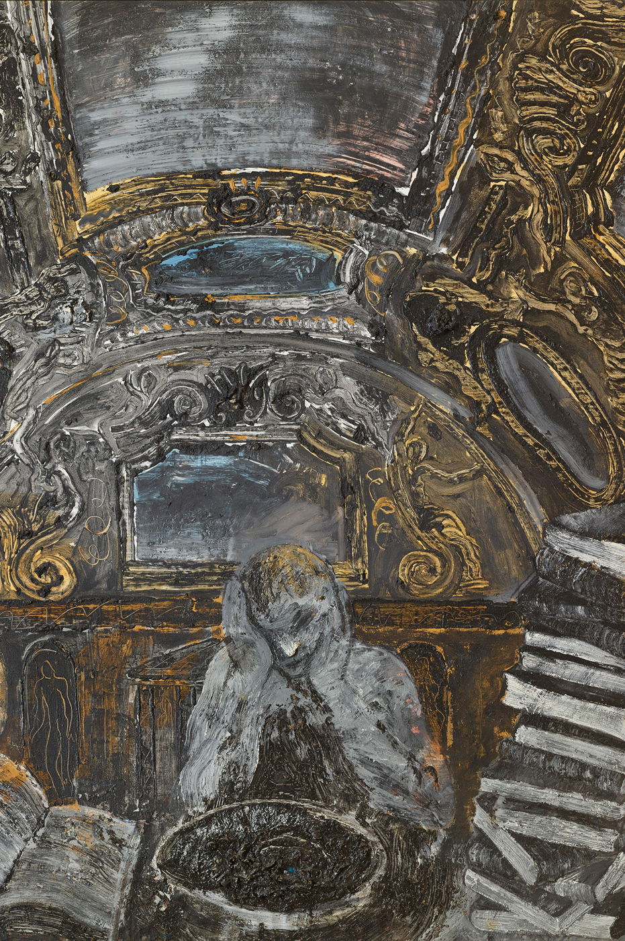
Demonstration of Learning (DOL)
Write a sentence using each vocabulary word on your handout based on the image to the left.

Slide 45
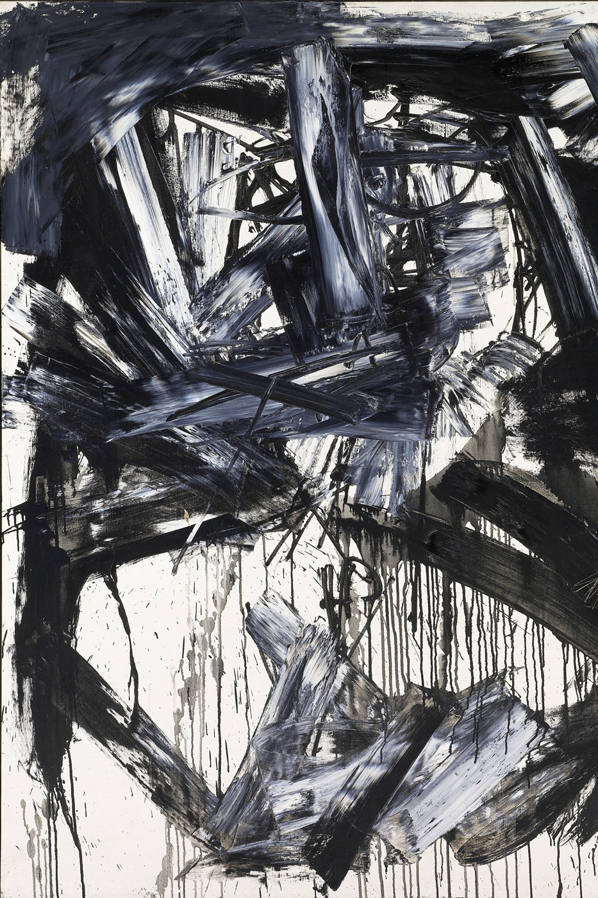
Learning to Look:
Art & Emotion Tour
K – 6th Grade
Students will explore how artists express emotions through color, facial expressions, and composition. Through guided discussions and activities, students will practice social-emotional skills such as identifying feelings, empathy, and perspective-taking. By connecting their own emotions to works of art, students will build confidence in expressing their thoughts while developing a deeper understanding of themselves and others.

Slide 46
Learning to Look: Art & Emotion Tour Objectives
Students will be able to...
identify how artists use visual elements—such as color, facial expressions, and composition—to express emotions in works of art,
interpret the emotions and perspectives of characters in artworks, using visual clues to support inferences, and
make personal connections to works of art by reflecting on and expressing their own emotions and experiences.

Slide 47
Learning to Look: Art & Emotion Tour Vocabulary
Color: the way we see light; artists use color to show feeling
Line: a mark that can show movement, emotion, or shape
Shape: flat areas made by lines (like circles, squares, or blobs)
Texture: how something feels or looks like it feels (rough, smooth, bumpy)
Composition: how everything is arranged in the artwork
Portrait: a picture of a person
Figure: a person or character in a work of art
Feelings: what we feel inside, such as happy or nervous
Empathy: understanding how someone else feels
Perspective: seeing things from another person’s point of view
Expression: showing how you feel (with your face, body, or voice)
Mood: the feeling or atmosphere in the artwork
Body language: the way someone’s body shows how they feel
Facial expression: how someone’s face shows a feeling

Slide 48
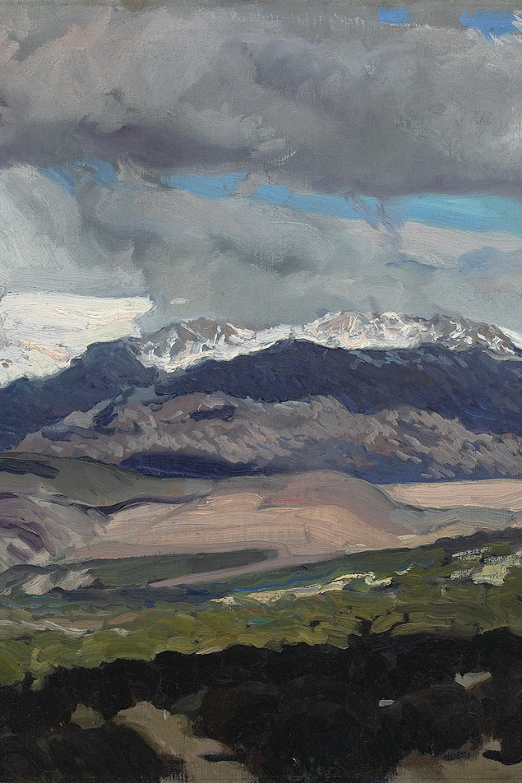
Demonstration of Learning (DOL)
Work in teams and take turns drawing a vocabulary word. The player who draws the word will give their team clues to help them guess it, but they may not say the word itself or use any part of it in their explanation. Teams will have two minutes to guess as many words as possible. The team that correctly guesses the most words within the time limit wins.

Slide 49
See you soon at the Meadows Museum!

