Slide 1
Meadows Museum
Pre-Visit Lesson

Slide 2
Learning Objectives
Students will be able to...
define museum.
understand what a visit to the Meadows Museum is like.
describe appropriate museum behavior.
interpret how long it takes to look at a work of art.
know the learning goals of the tour at the Meadows Museum.
define specific tour vocabulary.

Slide 3
Have you been to a museum before? What kind of museum did you visit? What was it like?

Slide 4
What is a museum?
A museum is a place that collects and preserves things. People visit museums to learn about these things. They can learn about them by looking, talking, and making.

Slide 5
Why do you think museums are important?

Slide 6
The Meadows Museum …
is an art museum of art from Spain.
is located on the campus of Southern Methodist University in Dallas.
was founded by Algur H. Meadows.
opened in 1965.
How old is the museum today?

Slide 7
When you arrive, …
the bus will drop you off in front of the museum. You will use the stairs or the elevator in the parking garage to get to the museum's entrance.

Slide 8
When you enter the museum, …
your teacher will check in at the front desk, and your docent will meet you in the lobby. A docent is a tour guide who will lead you through the galleries.

Slide 9
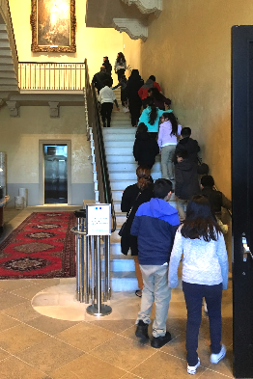
To get to the galleries, …
you can take the stairs or the elevator.

Slide 10
In the galleries, ...
you will look at artwork and share your ideas about it, but you cannot touch the art, frames, or pedestal stands.

Slide 11
Why can’t we touch the art?
Have each person stick a piece of clear tape to their finger.
Remove the tape from your finger and put the tape on a piece of white paper.
What do you notice about the paper? How is it different from a new piece of white paper?

Slide 12
Can you think of any other rules to follow when you visit an art museum?

Slide 13
When you are in the galleries, …
you cannot lean on the walls.
you cannot have food, drinks, or gum.
you cannot have large bags, backpacks, or other bulky items.
you can take pictures without flash.
you will stay with your class.
you will use an inside voice.
you will not run.

Slide 14
On your tour, …
you will look at art.
you will talk about art.
you might make art.
you might play games.
you might write about art.

Slide 15
How long do you think you will spend looking at each work of art?

Slide 16
Is 30 seconds enough time?
Start the timer below. Look at the work of art to the left. Make a mental list of all the things you see.

Slide 17
Do you remember ...
how many people are in the painting?
what they are wearing?
where they are?
what colors are in the painting?
if there are any objects in the painting?
if there are any animals in the painting?

Slide 18
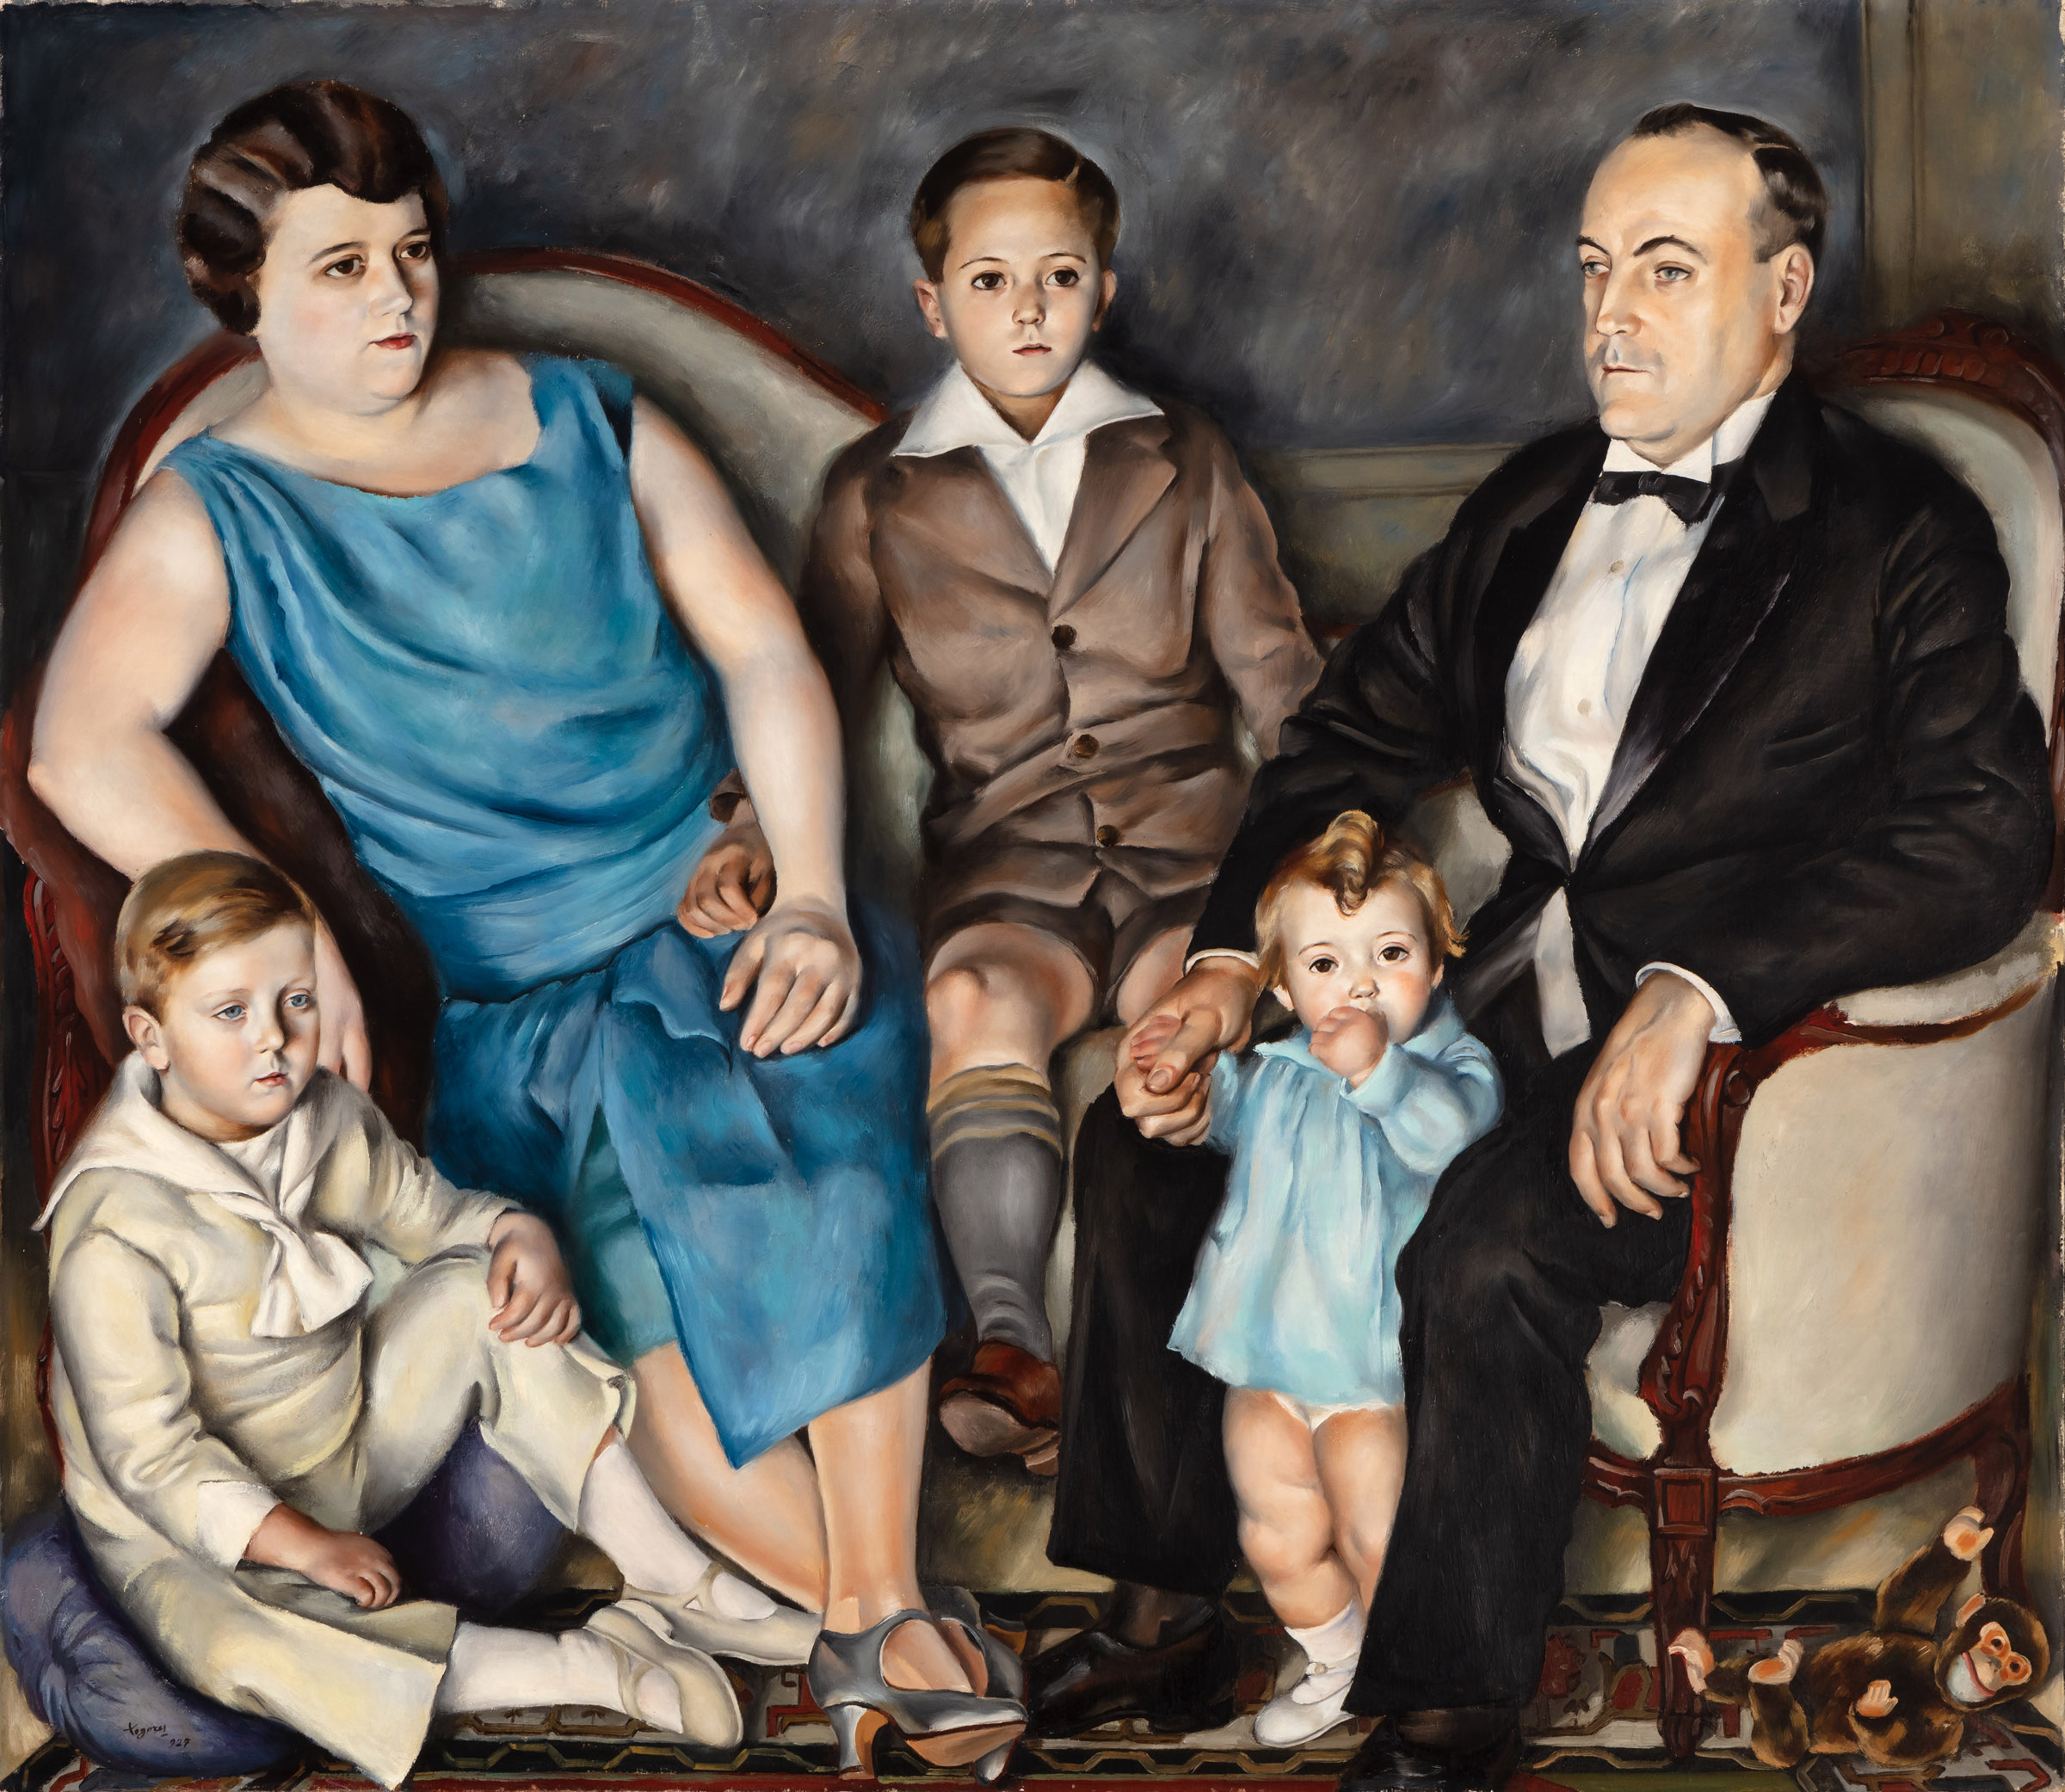
Is there anything you forgot? Is there anything you thought you saw, but didn’t?
How much more time do you think you needed?

Slide 19
Tour Specific Information

Slide 20
How to use these slides
The next slides include tour objectives and vocabulary for each tour type. (If you are not sure which tour type you are signed up for, check your confirmation letter.) Review the tour goals and objectives with your students. Following each tour vocabulary list is a slide for suggested activities to review the vocabulary terms. Feel free to add, edit, or delete slides to best serve your students.

Slide 21
Faces of Spain Tour
1st – 12th Grade
The Faces of Spain tour focuses on portraiture and the ways artists convey information about people through expression, pose, setting, dress, symbols, and other elements or attributes.

Slide 22
Faces of Spain Tour Objectives
Students will be able to...
define portrait.
understand the significance or purpose of portraits throughout history.
discuss elements of portraiture.
interpret aspects of the sitter such as their age, socio-economic status, time period, profession or hobbies, and emotions.

Slide 23
Faces of Spain Tour Vocabulary
Portrait: a representation of a person or a group of people.
Sitter(s): the person or people who is/are shown in a portrait.
Self-portrait: a portrait of the artist that created it.
Facial Expression: the way the different parts of the face work together to show emotion.
Gestures: what the sitter does with his or her hands.
Posture: the position of the body of the sitter.
Setting: the place or environment in which the sitter is shown.
Attire: the clothing the person in the portrait is wearing.
Props: the things the sitter is holding or is surrounded by.
Commission: to order something to be made.
Artist: someone who creates art.

Slide 24
Demonstration of Learning (DOL)
Portrait Sitter Facial Expression Gestures
Posture Setting Attire Props Commission
Using the vocabulary words above, write a short story. Underline each of the vocabulary words in your story. Your story should be at least 3 paragraphs. Each paragraph should be 4-5 sentences long.

Slide 25
Form of Things Tour
6th – 12th Grade
The Form of Things tour focuses on three-dimensional works of art and considers the ways that dimensionality and material play a role in the work’s creation and reception. For example, when an artist creates a work, how might they balance potentially competing forces of design, material limitations and strengths, and challenges inherent to three-dimensionality? How do the artist’s decisions affect the way viewers experience the work?

Slide 26
Form of Things Tour Objectives
Students will be able...
to define sculpture.
explain the difference between 2D and 3D art.
analyze the relationships between structure, materials, process, environment, and use of sculptures.

Slide 27
Form of Things Tour Vocabulary
Abstract Art: A work of art in which the artist uses a recognizable subject but portrays it in an unrealistic manner. Abstraction is a generalization, a simplification of forms. It may be reflecting an emotion or feeling, rather than telling a story, and recognizable forms may be distorted, or rearranged.
Additive: Sculptural process that produces a form by combining or building up material from a core or armature. Modeling in clay and welding steel are additive processes.
Bronze: Bronze is composed of various alloys of copper and tin, sometimes with other metals. A bronze sculpture is most often created through the lost-wax method of casting.
Casting: The act of making a work of art from a hollow mold by pouring molten metal, liquid plaster, or other material into the mold to let it cool and harden.
Collage: The process of gluing or attaching paper or objects to a two-dimensional surface.

Slide 28
Form of Things Tour Vocabulary
Geometric Shapes: Shapes that are precise and look as if they were made with a ruler. The square, the rectangle, the triangle, the circle, and the oval, are the five basic geometric shapes.
Modeling: An additive sculpture process in which material is built up into the final product, often over an armature (the wooden or metal framework that supports a large work of sculpture). The material must be pliable, such as clay, wax, or plaster, and the sculptor uses his/her hands and tools to build up the form.
Negative Space: In sculpture, this refers to the empty spaces between the forms, and the space surrounding it.
Organic Shapes: Shapes that are irregular or uneven. Their outlines curve to make free-form shapes. Organic shapes are often found in nature.
Positive Space: In sculpture, this refers to the actual form of the object.
Pylon: a tower-like structure.

Slide 29
Form of Things Tour Vocabulary
Texture: Texture is the way something feels when you touch it. Artists also create the illusion of texture in artworks such as paintings, drawings and prints. A rough texture can be created through flaking, sharp, coarse materials. Smooth textures can be created using shiny, polished, clean surfaces.
Scale: The comparative size of a thing in relation to another like thing or its ‘normal’ or ‘expected’ size. Scale may refer to an entire work of art or to elements within it.
Subtractive: Sculpture made by removing material from a larger block or form through chiseling or carving.

Slide 30
Demonstration of Learning (DOL)
On your handout, sketch or draw the definition of each vocabulary word.

Slide 31
Learning to Look Tour
1st – 5th Grade
The Learning to Look tour focuses on three aspects of art: 1) the elements of art, 2) how art can tell stories, and 3) how art can connect to our lives.

Slide 32
Learning to Look Tour Objectives
Students will be able to...
identify the elements of art in a work of art.
interpret the stories artists tell through their artwork.
make connections between works of art and their own lives.

Slide 33
Learning to Look Tour Vocabulary
Line: a mark made upon a surface (i.e. horizontal, vertical, wavy, diagonal)
Shape: areas of enclosed space that are two-dimensional (have height and width)
Form: the three-dimensional version of a shape (has height, width, and depth); can be viewed from different angles and is not flat
Space: the illusion of depth on a flat surface (i.e. overlapping shapes, smaller shapes in background vs. larger in foreground)
Color: made up of three properties: hue, intensity and value
Hue: color name (i.e. red)
Intensity: quality of brightness and purity (strong, bright vs. faint, dull)
Value: lightness and darkness (changes when black or white are added)
Texture: describes the surface quality of an object

Slide 34
Demonstration of Learning (DOL)
Half the class will receive vocabulary word cards. The other half of the class will receive vocabulary definition cards. When I say go, find your match. When you think you have found your match, check in with me. The first pair to correctly match, wins!

Slide 35
See you soon at the Meadows Museum!

